Slide 1

Statisticians at Work: Inspiration, Aspiration, Ambition 统计学者的工作及风范: 灵感,抱负,雄心 C. F. Jeff Wu (吴建福) Georgia Institute of Technology
Accomplishments(成就) vs. Scholarship(风范)
Three levels of statistical research (三个境界):
inspiration, aspiration, ambition
Examples from history (Pearson, Fisher,
Neyman, Box, Tukey, Efron, etc.)
Statistics in China: diagnosis and suggestions

Slide 2



Three Levels of Statistical Research (统计研究的三个境界)
Inspiration: 灵感，启示
(more spiritual ☺)
Aspiration: 抱负，志向
(more pragmatic, can be spiritual ☺)
Ambition: 雄心, 热望
(如果是目标性或功利性 ☹)

Slide 3
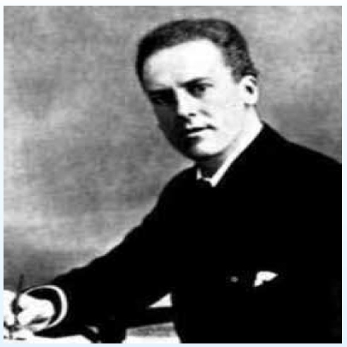
Karl Pearson (1857-1936), Founder of Biometrika (1901)
Note: Seven of the next 8 slides adapted from Alan Agresti’s talk

Slide 4
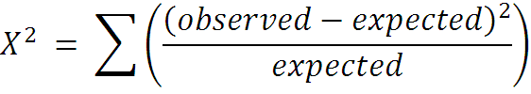



Karl Pearson (1900) Philos.Mag.
Introducing chi-squared statistic
testing values for multinomial probabilities
testing fit of Pearson curves
testing statistical independence in contingency table ( )

Slide 5
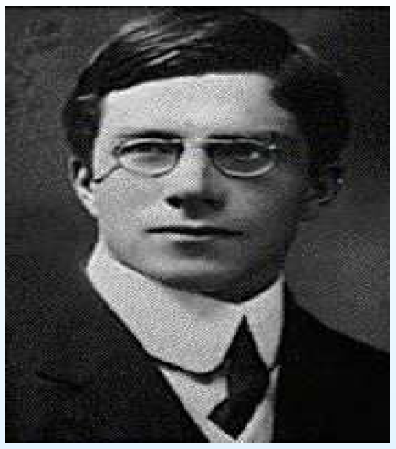
R. A. Fisher (1890-1962)

Slide 6


Fisher (1922)
Introduces degrees of freedom with geometrical argument
Shows that when marginal proportions in table are estimated, the additional constraints imply
K.Pearson (1922)
“Such a view is entirely erroneous. The writer has done no service to the science of statistics … . I trust my critic will pardon me for comparing him with Don Quixote (唐.吉柯德) tilting at the windmill (风车); he must either destroy himself, or the whole theory of probable errors, for they are invariably based on using sample values … .”

Slide 7
Fisher’s Retort ☹
In a later volume of his collected works (1950), Fisher wrote of Pearson,
“If peevish (易怒) intolerance of free opinion in others is a sign of senility (老昏), it is one which he had developed at an early age.”

Slide 8
Fisher, Greatest Statistician
In 1919, Fisher came to Rothamsted Agricultural Research Station for his first job. The pile of data led to his great invention of Analysis of Variance and Design of Experiments
Design must go hand in hand with Analysis;
Design is not merely a selection of points (布点)
Three fundamental principles: replication (重复), blocking (分区组), randomization (随机化). Among them, randomization was the most original and unexpected invention. Randomization and likelihood function (似然函数) are uniquely statistical, good examples of statistical thinking

Slide 9

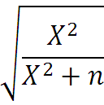

Karl Pearson (1904)
Advocates measuring association in contingency tables by approximating the correlation for an assumed underlying continuous distribution
tetrachoric correlation ( , assuming bivariate normality)
contingency coefficient based on for testing independence in contingency table

Slide 10






George U. Yule (1871-1951)
Advocates measuring association using odds ratio
“At best the normal coefficient can only be said to give us… a hypothetical correlation between supposititious variables. The introduction of needless and unverifiable hypotheses does not appear to me a desirable proceeding in scientific work.”
(1911) An introduction to the Theory of Statistics (14 editions)

Slide 11
K.Pearson, with D.Heron (1913) Biometrika
“Unthinking praise has been bestowed on a textbook which can only lead statistical students hopelessly astray (迷途).”
.
“If Mr. Yule’s views are accepted, irreparable damage will be done to the growth of modern statistical theory… Yule’s has never been and never will be used in any works done under my supervision. … Yule must withdraw his ideas if he wishes to maintain any reputation as a statistician.”
and so on, for 150 pages

Slide 12
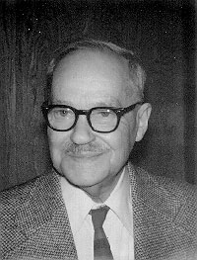
Jerzy Neyman (1894-1981)

Slide 13
Jerzy Neyman (1894 - 1981)
Came to University College of London from Poland to learn from Karl Pearson (1925)
Teamed with Egon Pearson (son of KP) to invent the Neyman-Pearson theory of hypothesis testing; Notion of null vs. alternative hypothesis; Neyman-Pearson Lemma (an optimality property)
Invented theory of confidence estimation (controversy with Fisher regarding fiducial intervals)
Came to found Berkeley Statistics Dept. (1938)

Slide 14









Jackknife: Original Version
Bias reduction (M. Quenouille, 1956)
Jackknife bias estimator:
Quenouille’s motivation was from time series, not the best setting for the method; also reduced bias can lead to increased variance
;
(delete )
;
bias( )
;
;
bias( )

Slide 15
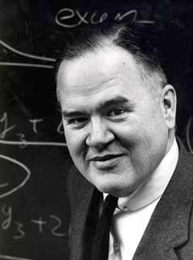
John W. Tukey (1915-2000)

Slide 16







Tukey’s Jackknife
Jackknife variance estimator:
Conjectured:
(i) are nearly i.i.d.
(ii) has approx. same variance as
: Jackknife pseudo value
(for )

Slide 17
Bias and Confidence in Not-quite Large Samples (Preliminary Report) J.W. Tukey
The linear combination of estimates….by Jones (1956). Let be the estimate based on the data, that based on all but the ith piece, the average of the . Quenouille (Biometrika, (1956)), has pointed out some of the advantages of as such an estimate of much reduced bias. Actually, the individual expressions may, to a good approximation, be treated as though they were independent estimates. Not only is each nearly unbiased, but their average sum of squares of deviations is nearly times the variance of their mean, etc. In a wide class of situations they behave rather like projections from a nonlinear situation on to a tangent linear situation. They may thus be used in connection with standard confidence procedures to set closely approximate confidence limits on the estimand.
Ann. Math. Stat. 29, 614, 1958

Slide 18
Significance and Impact of Tukey’s Work
First one to recognize and propose jackknife
as a resampling method for inference
Another record: the 1958 paper (or abstract)
has the highest I/P ratio ☺
(I=impact, P=pages)
Inspiring Efron’s work on the bootstrap
Note the title of Efron’s 1979 paper “Bootstrap methods: another look at the jackknife”

Slide 19




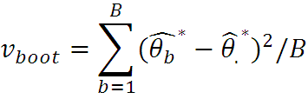


Bootstrap
: simple random sample with replacement from ; ,
Bootstrap variance estimator:
Estimation of sampling distribution:

Slide 20
Fast Fourier Transform (FFT) and Design of Experiment
“An algorithm for the machine calculation of complex Fourier Series” by Cooley and Tukey, 1965, Mathematics of Computation
An efficient method for the calculation of the interactions of a factorial experiment was introduced by Yates and is widely known by his name. The generalization to was given by Box et. al. Good generalized these methods and gave elegant algorithms for which one class of applications is the calculation of Fourier series. In their full generality, Good’s methods are applicable to certain problems in which one must multiply an N-vector by an N N matrix which can be factored into m sparse matrices, where m is proportional to log N. This results in a procedure requiring a number of operations proportional to NlogN rather than N N . These methods are applied here to the calculation of complex Fourier series. They are useful in situations where the number of data points is a highly composite number.

Slide 21
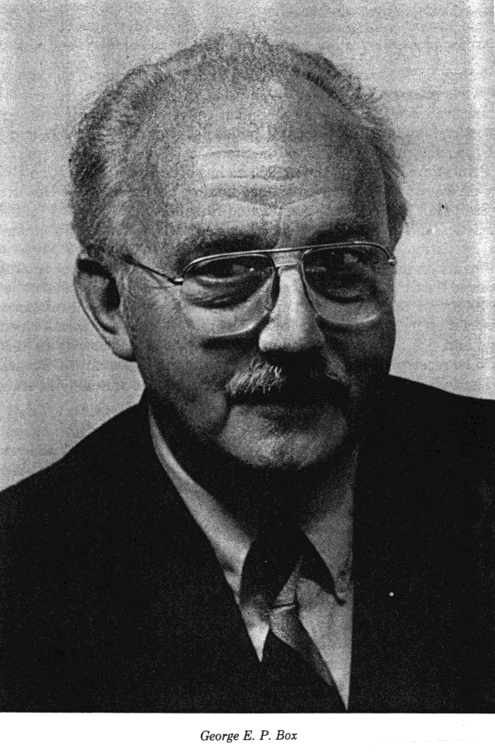
George E. P. Box (1919-)

Slide 22
Box’s Response Surface Methodology(RSM)
In 1948-56 Box (ex-son-in-law of Fisher) worked at
Imperial Chemical Ind(ICI). He discovered that factorial
designs (Yates, Finney) were not suitable for chemical
process optimization. Factorials were invented for
treatment selection in agricultural expts
In process study, most variables are quantitative and
regression models are more suitable, while in agricul.
expts some variables are qualitative and ANOVA are
more suitable. This led to his paradigm shift and
breakthrough
He invented the central composite designs (中心复合设
计) for conducting optimization expts and RSM for
modeling and optimization

Slide 23
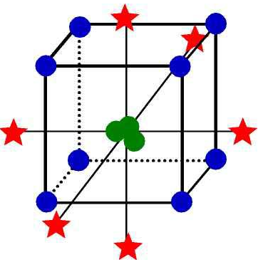
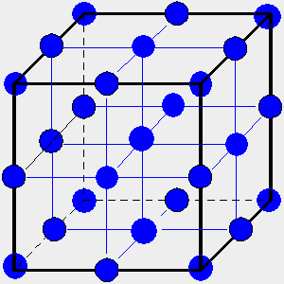
Central Composite Design vs. Design
Central composite design :15-17 points, can estimate
all linear, quadratic main effects (6) and
interactions (3) (total: 9 terms)
design: 27 points, can estimate all linear, quadratic
main effects (6), all their 2nd-order interactions (12)
and 3rd-order interactions (8) (total: 26 terms;
saturated); 3rd order effects often unimportant
not good use of degrees of freedom

Slide 24
Essence of Response Surface Methodology
It consists of three components
Choice of design points and criteria: central composite designs, Box-Behnken designs, all-bias designs (Box-Draper), rotatable designs, integrated prediction mean squared errors, also inspiring work in A-, D-, I-optimal designs (Kiefer)
Regression modeling (thus the name 回归设计 in Chinese for such designs, a better term ☺ than in English), estim. replication error using center points
Optimization: steepest ascent, quadratic opt., Nelder-Meade simplex method for optima seeking, etc.

Slide 25
A Modern System of Experimental Design
Regular orthogonal designs ( Fisher, Yates, Finney, …):
designs, using minimum aberration criterion
Nonregular orthogonal designs (Plackett-Burman, Rao, Bose): Plackett-Burman designs, orthogonal arrays
Response surface designs (Box) : fitting a parametric response surface
Optimal designs (Kiefer): optimality driven by specific model/criterion

Slide 26
Two Types of Fractional Factorial Designs
Regular ( designs):
columns of the design matrix form a group over a finite field; the interaction between any two columns is among the columns
⇒ any two factorial effects are either
orthogonal or fully aliased
Nonregular (mixed-level designs, orthogonal arrays)
some pairs of factorial effects can be partially aliased
⇒ more complex aliasing pattern

Slide 27
Useful Orthogonal Arrays
Collection in WH
Run Size Economy vs.16-run designs, vs. 27-run designs,
Flexibility in level combinations

Slide 28
Partial and Complex Aliasing
For the 12-run Plackett-Burman design OA(12, 2¹¹)
partial aliasing: coefficient
complex aliasing: partial aliases, which
can lead to search of tens of millions models!!
Traditionally complex aliasing was considered to be a disadvantage ☹
Standard texts pay little attention to this type of designs
In 1986 I saw successful case studies in Japan using OA(12), OA(18), OA (36), leading me to think there was something deeper about nonregular designs

Slide 29
A New Paradigm (新典范)
Traditionally experiments with complex aliasing were used for screening purpose, i.e., estimating main effects only
A paradigm shift: using effect sparsity and heredity principles, Hamada-Wu (1992) recognized that complex aliasing can be turned into an advantage for studying interactions
Analysis methods (frequentist and Bayesian) allow two-factor interactions to be entertained (in addition to main effects). Effective if the number of significant interactions is small

Slide 30
Follow-up Work
It has rejuvenated the research on the class of nonregular designs, including the extension of the minimum aberration design theory to nonregular designs (Cheng, 郑清水; Tang, 唐伯欣; Xu, 徐洪泉; etc.)
It has also inspired a new approach to response surface methodology
Effect heredity principle (效应遗传原则)(Hamada-Wu 1992) has a bigger impact in model selection in machine learning (Yuan (袁明)-Joseph, 07, 09), a pleasant surprise ☺

Slide 31

Statistical Work in China
Limited progress in first 40 years
Weak tradition: few early pioneers, early death
of Hsu (许宝騄)
System not conducive to healthy development:
stat society/discipline as secondary(二级)part of
math, few stat depts, most within math
math criteria to promotion, hiring, award, etc.
Favor mathematical work, little consensus on
how to judge applied work, waste of
opportunities in this vast country

Slide 32
Improvement in Last 20 Years
More statistics depts/programs, big national programs (千人, 长江) attracting overseas visitors, better communications with outside world, very encouraging ☺
Expatriate Chinese (海外华人) doing well in stat, becoming a major force in US, helping China too
Improvement in concrete measures: more SCI papers and papers in top journals, but danger in using superficial measures, e.g., impact index; also some SCI journals are low quality
Too much ambition, less inspiration ☹

Slide 33
Landscape of Statistical Science
Three broad categories: theory, methodology, application with overlapping boundaries
Theory: technical (= mathematical statistics in China?) and less technical
Interface (界面) between theory, methodology, application: abundant opportunities in China but not fully recognized or encouraged in current system,
example: journal ranking (next slide)

Slide 34
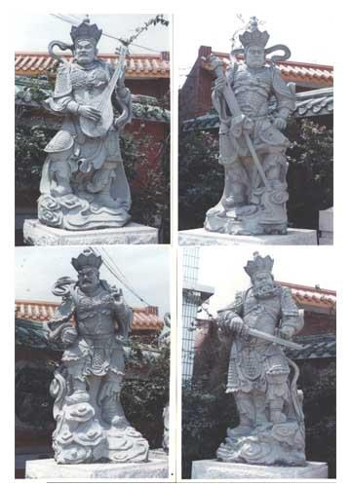
The Big Four (四大天王)?

Slide 35
The Big Four (四大天王)?
Best four journals for promotion/award:
Annals, Biometrika, J.Am.Stat.Assoc, J.Roy.Stat.Soc.B
They are the top 4-5 理论、方法杂志
Other equally good ones with specialization like
Biometrics, Technometrics, IEEE, ASME, J.Machine.Learning, other CS and biology journals
Singling out these four has adverse effects (负面作用)
Use a broader list of journals, judge quality of individual papers, not journal’s name or its impact index
(四大天王削减为三大天王?? Bmka out?)
I will go further: give more credits to good applied papers and projects

Slide 36
Applied Statistics in China
Gap or disconnect between successful real application and good published work
No such tradition or working model to emulate (until recent imports)
Less discipline on the part of investigator to write up for publication; language handicap in writing applied papers less inclined to submit to western journals
Current system does not give due reward for or recognition of good applied work

Slide 37
Mathematical/Theoretical Statistics in China
Easier to enter for math-oriented beginners, less language barrier in writing
Done good work since 1950’s, much more in last 10 years, very encouraging ☺
Seems to be dominated by work in asymptotic theory
Strength in asymptotic theory should be maintained, but there are good and not-so-good asymptotics

Slide 38
Good Asymptotics
Technically very hard but expected result: C. Stone’s work in 1970s on fully efficient adaptive estimation
Surprising result, not hard to prove: Stein’s discovery on better estimator (James-Stein) than normal means for p≥3; Stein’s later proof using integration-by-parts Lemma more elegant and applicable to other problems
Clever and elegant: LeCam’s contiguity lemma for computing asympt power of test
Technically hard and real impact: high dimensional statistics (Bickel, Donoho, Johnstone, etc.)

Slide 39
Less Interesting Asymptotics
Asymptopia (= asymptotics + utopia, 大样本的乌托邦) coined by J. Friedman: asymptotic results no bearing on actual performance; however, inconsistency result can shed new light, e.g., AIC (赤池准则) inconsistent for model selection but good finite sample perf., led to new theory
Gloried Taylor Series Expansions: heuristics using expansions often suffice in getting results (Bmka style); asymptotics is used to fill in the technical gaps under regularity assumptions (Ann style), see Speed article
Ann. Stat. has many pioneering articles; but what % of its many pages are interesting? (4312 pages in 2009!!)

Slide 40
Terry Speed: You want a proof?
“Of course you can pile on assumptions so that the proof is easy. If checking your assumptions in any particular case is harder than checking the conclusion in that case, you will have joined a great tradition .”
“By the time a few people have tried the new procedure, each time checking its suitability by simulation in their context, we will have built up a proof by simulation.”
“I think in statistics we need derivations, not proofs. That is, lines of reasoning from some assumptions to a formula, …, might provide some insight. The evidence that this might be the case can be mathematical, not necessarily with epsilon-delta rigour, simulation, or just verbal. Call this ‘a statistician’s proof ‘.”
IMS Bulletin, December, 2009, Terence’s Stuff

Slide 41
One suggestion (一个建议), Three As-Well’s (三个并重)
More inspiration/aspiration, less ambition
多点灵感, 抱负, 少点雄心, 热望
(“大道至简, 大美天成”, 严加安院士, 2010)
Accomplishments as well as scholarship
成就, 风范并重
Theory as well as applied
理论, 应用并重
Domestic as well as foreign
国内 (中文), 国外 (英文) 并重

Slide 42
Advice for Young Researchers: Three Dos and Don’ts (三要, 三不要)
Quality, not quantity
要质, 不要量
(“厚积薄发”, 华罗庚)
Substance yes, label no
要本质, 不要标签
To do or not to do
有所为, 有所不为*
*最高境界

